Slide 1
RECOMMENDER SYSTEM FOR GROCERIES CONTRACTOR
(The Battle of Neighborhoods)
Applied Data Science Capstone
IBM DATA SCIENCE PROFESSIONAL CERTIFICATE
April 2019
Mohamed Adel

Slide 2
PROBLEM DESCRIPTION
Recommender System for Groceries Contractor
To provide a groceries contractor (in one of the boroughs of Toronto - Scarborough) recommendations for optimized warehouse location
Supplier to various Restaurants, Bakery, Breakfast Spot, Brewery, Cafe (with fresh and high quality groceries)
The contractor wants to build a warehouse for the groceries it buys from villagers and farmers inside the borough, so that they will support more customers and also bring better "Quality of Service" to the old customers.
The contractor should build this warehouse where it is closest to its customers in order to minimize the cost of transportation in addition to the example above.
Finding the right neighborhood is our mission and our recommender system will provide this contractor with a sorted list of neighborhoods in which the first element of the list will be the best suggested neighborhood.

Slide 3
DATA
Geo-locational information (latitude and longitude )about that specific borough and the neighborhoods in that borough.
Data about different venues in different neighborhoods of that specific borough.
"Foursquare" locational information to be used. ( basic and advanced information about that venue)
A typical request from Foursquare will provide us with the following information:
[Postal Code] [Neighborhood(s)] [Neighborhood Latitude] [Neighborhood Longitude] [Venue] [Venue Summary] [Venue Category] [Distance (meter)]
[M1L] [Clairlea, Golden Mile, Oakridge] [43.711112] [-79.284577] [Tim Hortons] [This spot is popular] [Coffee Shop] [592]

Slide 4
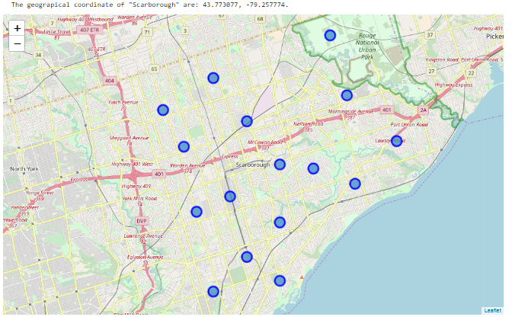
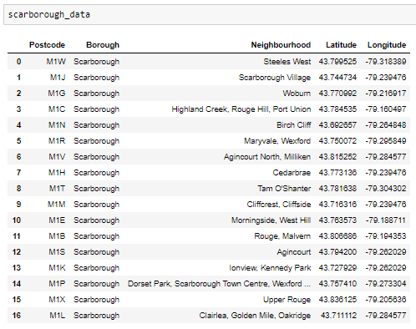
IDENTIFICATION OF POSTAL CODES

Slide 5
FOURSQUARE API ACCESS
Information about venues inside each and every neighborhood
Radius chosen: 1000 meter (venues that are at most 1000 meter far from the center of the neighborhood)
Processing on that raw data to find our desirable features for each venue.
Main feature is the category of that venue.
"Venue's Category" will be One-hot encoded and different venues will have different feature-columns.
Next Step: Integrating all restaurant columns to one column "Total Restaurants" and all food joint columns to "Total Joints" column

Slide 6
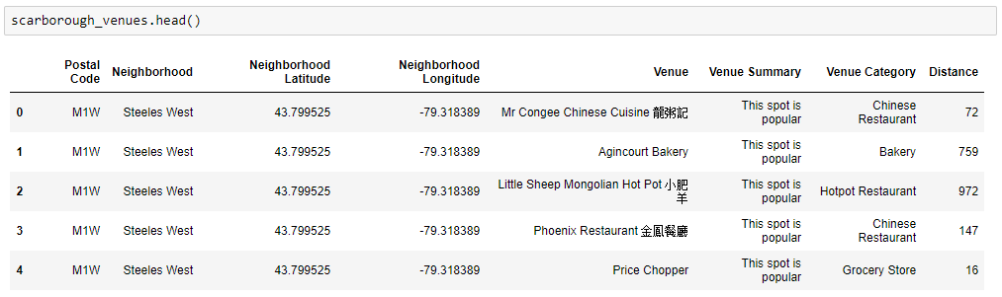
FOURSQUARE API ACCESS

Slide 7
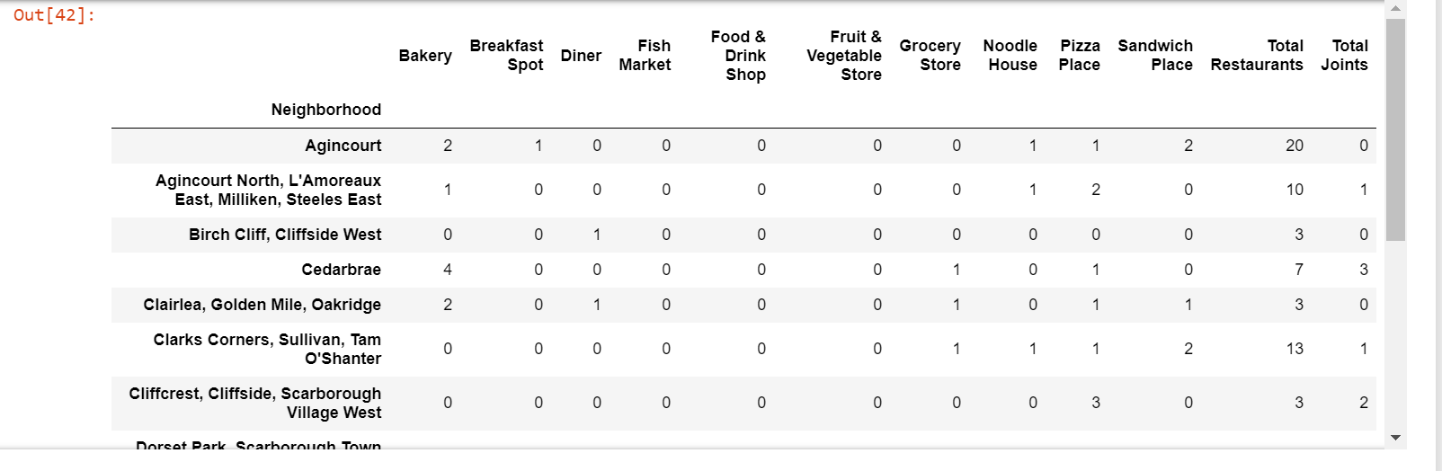
FINAL METADATA

Slide 8
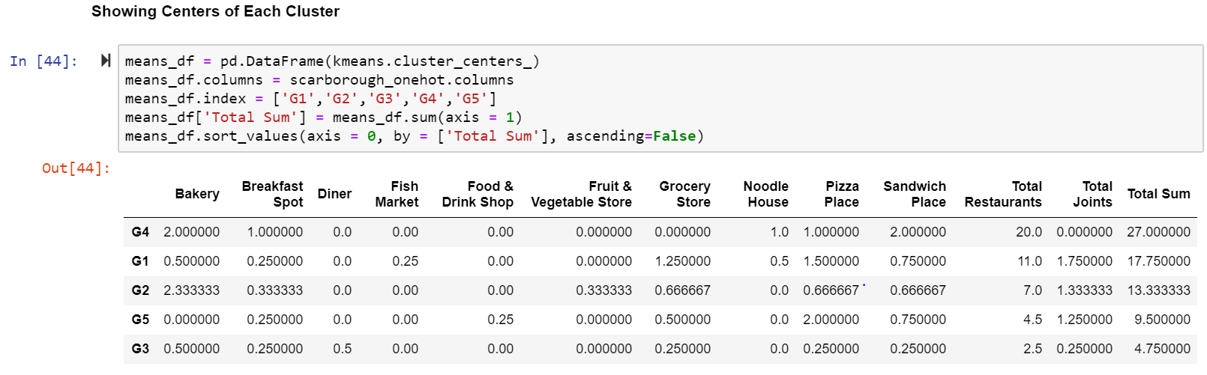
CLUSTERING
K-Means Clustering used
Number of clusters considered- 5

Slide 9
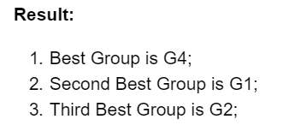
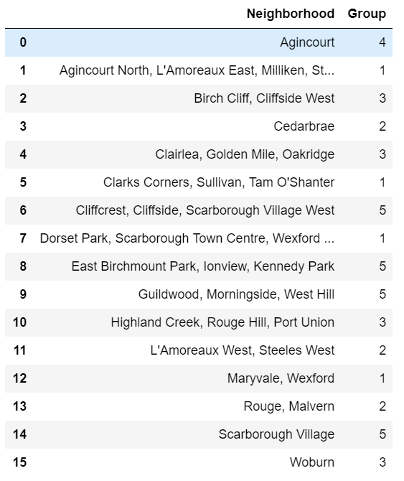
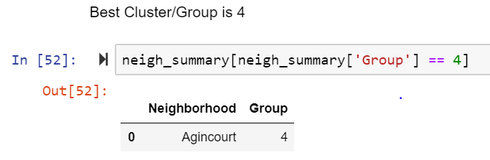
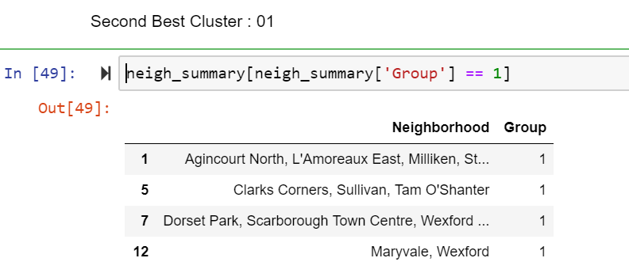
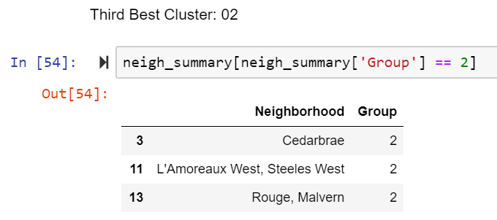
RESULTS
Recommendation based on Total Restaurants and Total Joints

Slide 10
THANK YOU.

